Slide 1
Photomicrographs of Plant foods
Dandelion
Permission to reproduce original photomicrographs used to make this collection may be obtained from
Dr. David O. Norris at
david.norris@colorado.edu

Slide 2
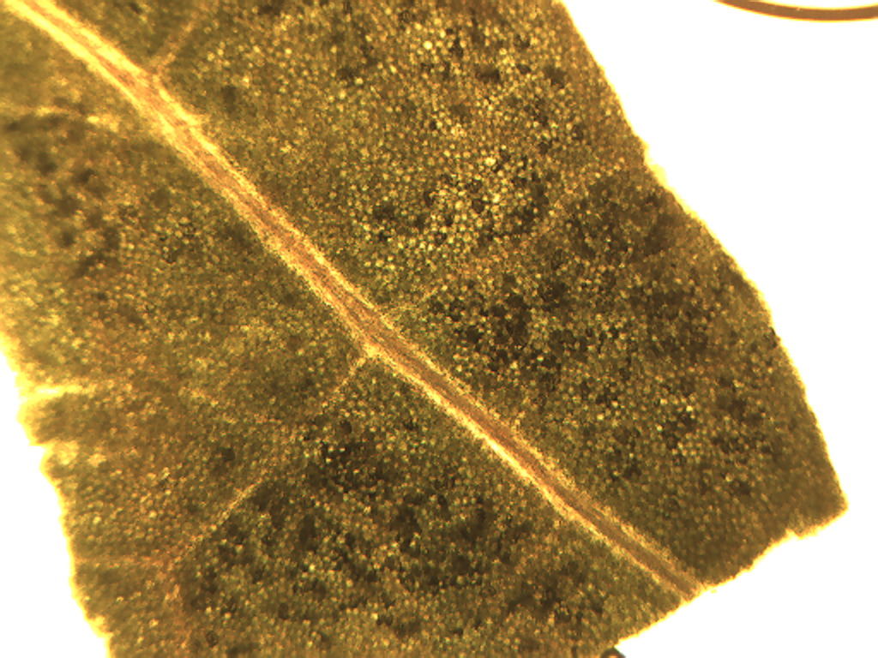
Notes:
153. Represented by many species. Dandelion. Leaf, 4X. Note thick vein (arrow).

Slide 3
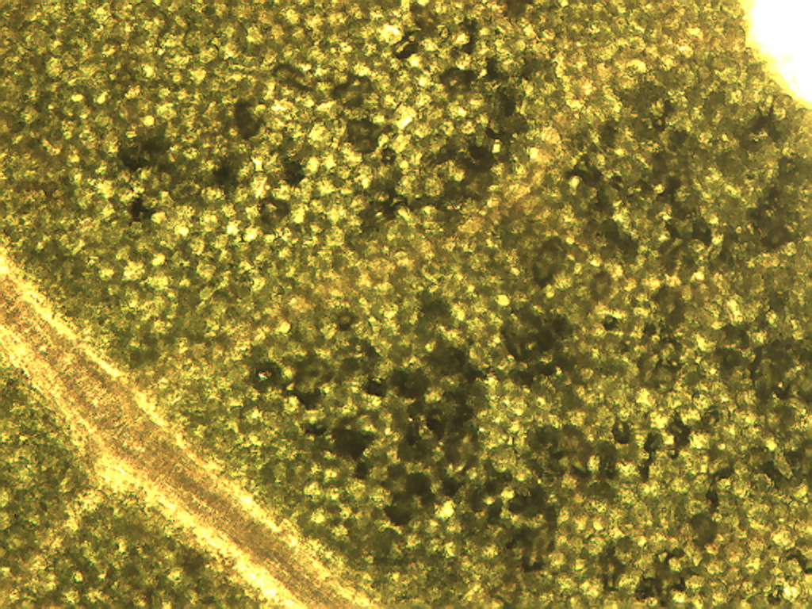
Notes:
154. Dandelion. Leaf surface, 10X.

Slide 4
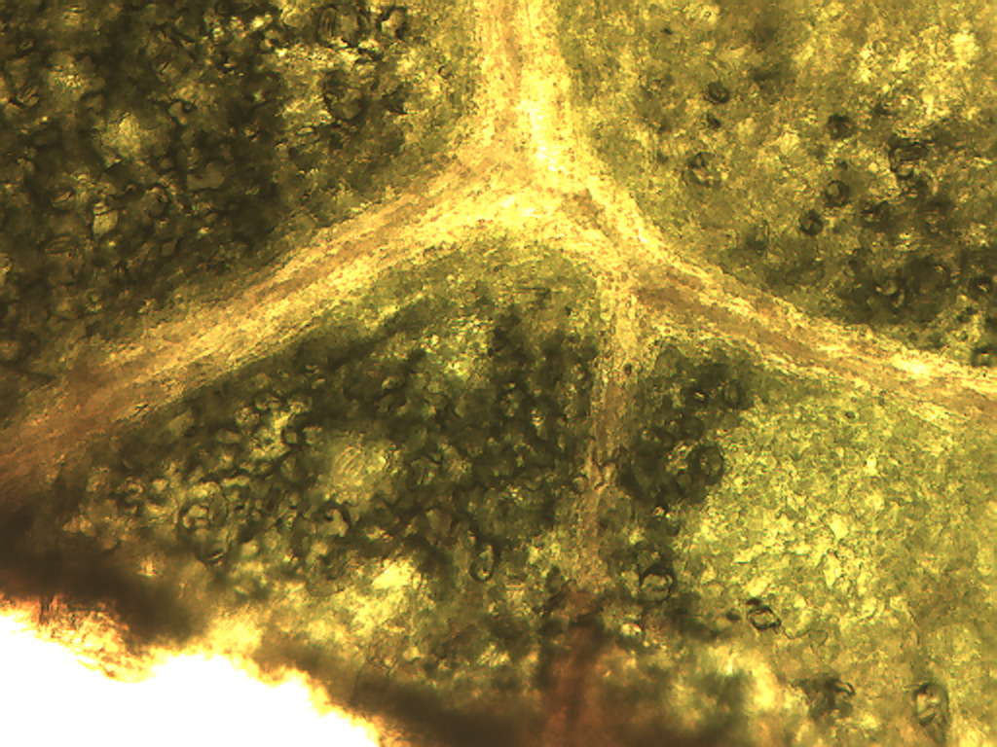
Notes:
155. Dandelion. Leaf, lower surface, 10X.

Slide 5
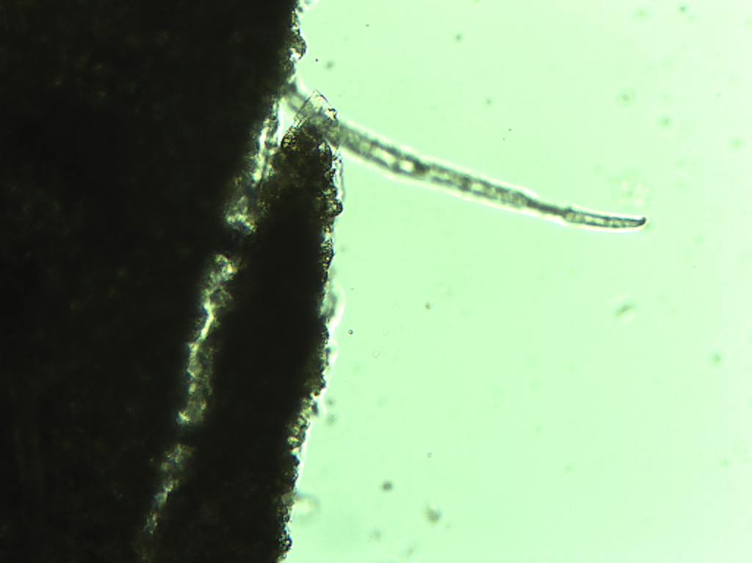
Notes:
156. Dandelion. Leaf unicellular trichome, 10X.

Slide 6
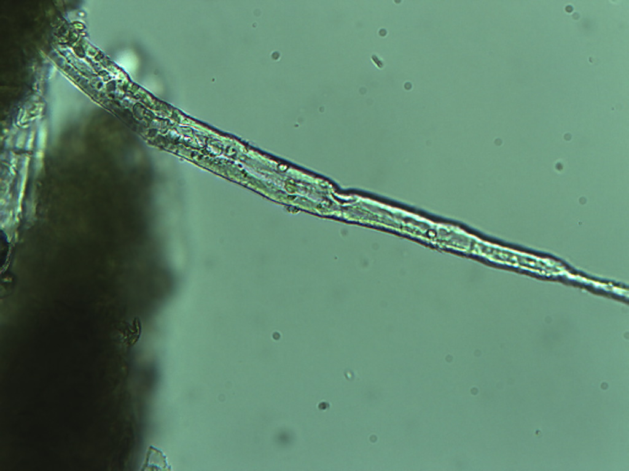
Notes:
157. Dandelion. Leaf unicellular trichome, 25X.

Slide 7
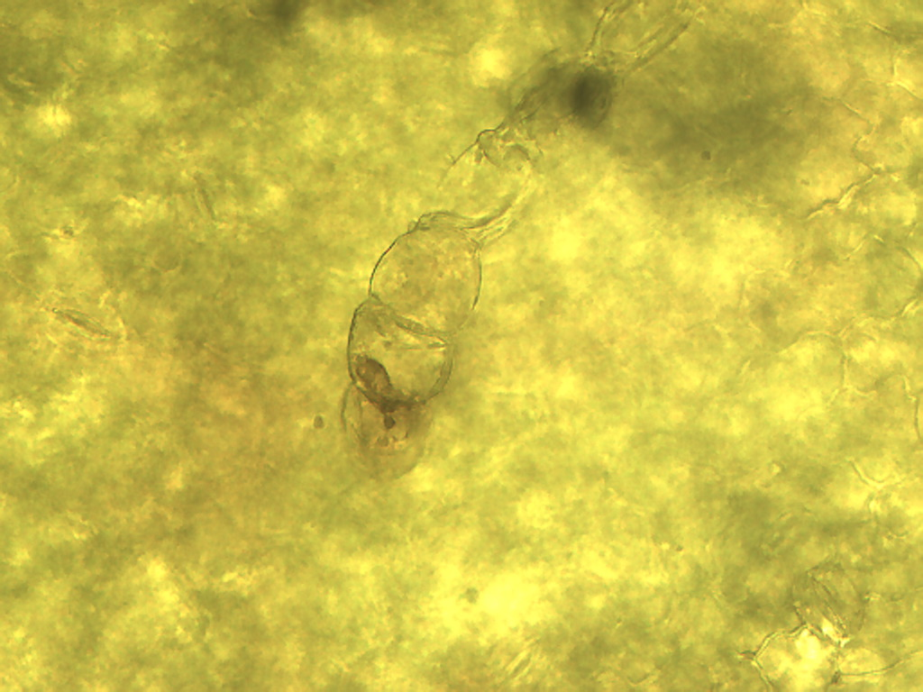
Notes:
158. Dandelion. Leaf capitate trichome, 25X.

Slide 8
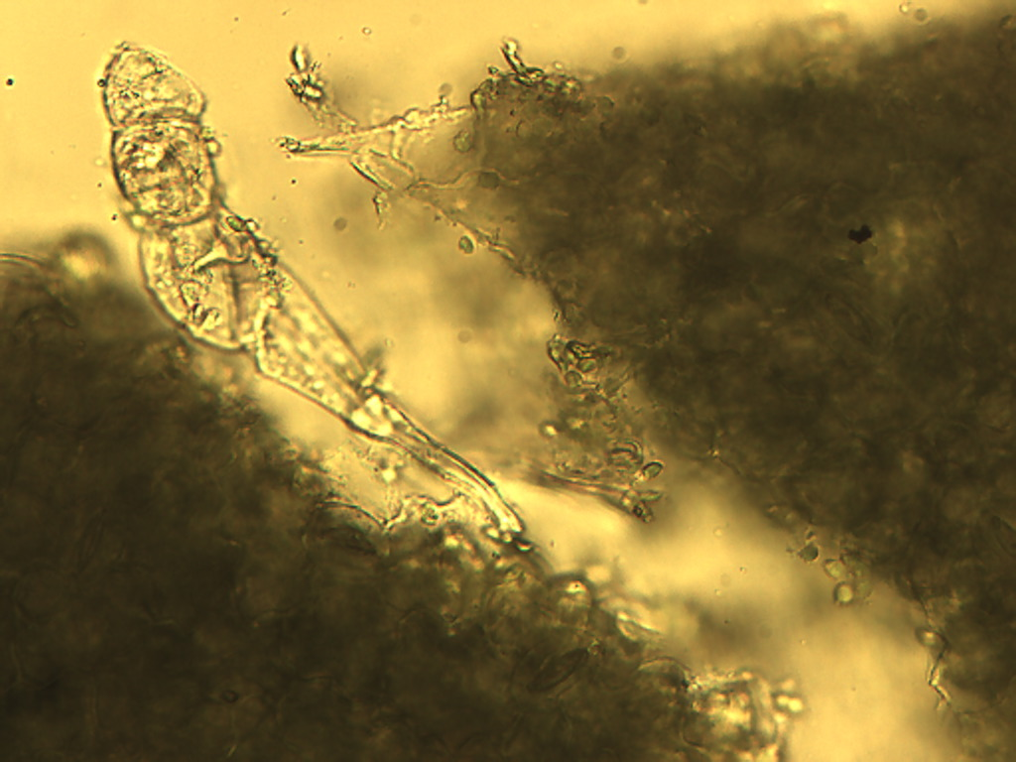
Notes:
159. Dandelion. Leaf capitate trichome, 25X.

Slide 9
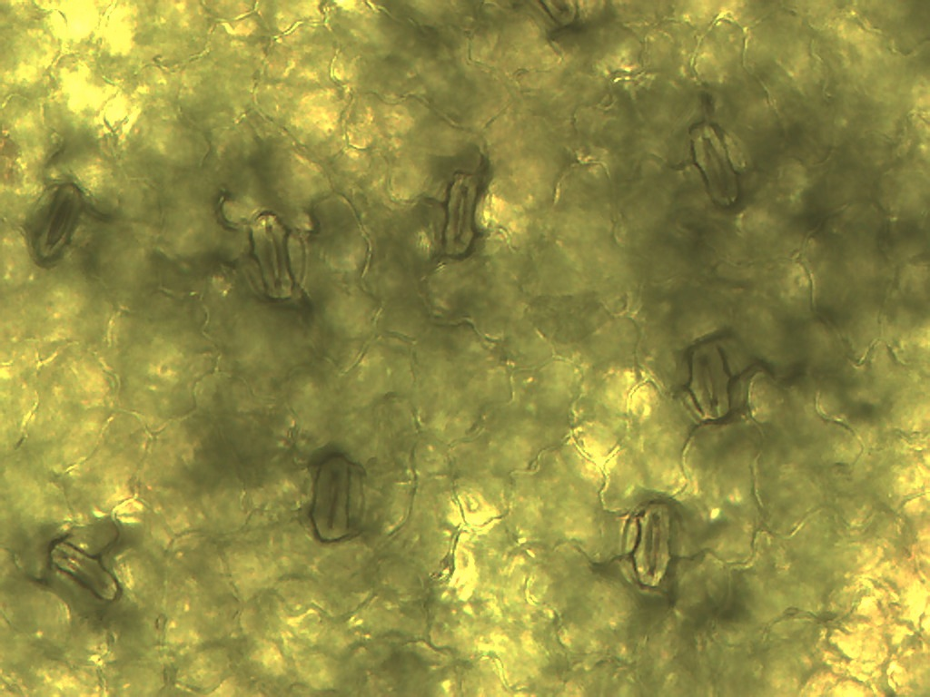
Notes:
160. Dandelion. Leaf epidermis, 25X. Stomates (arrows)

Slide 10
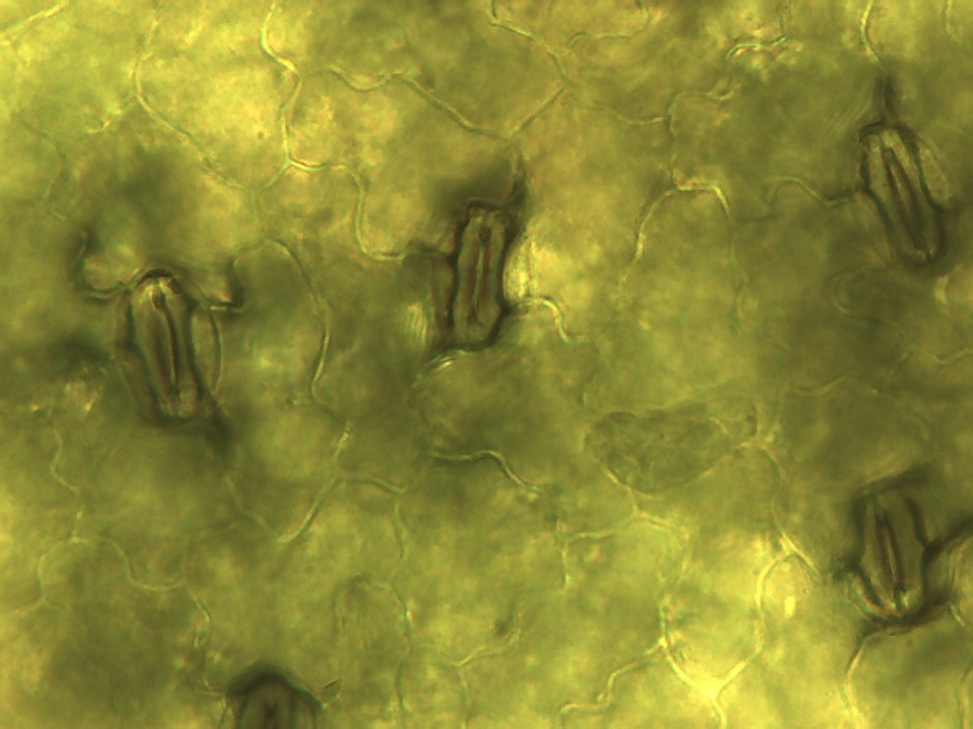
Notes:
161. Dandelion. Leaf epidermis, 40X. Stomate (arrow)

Slide 11
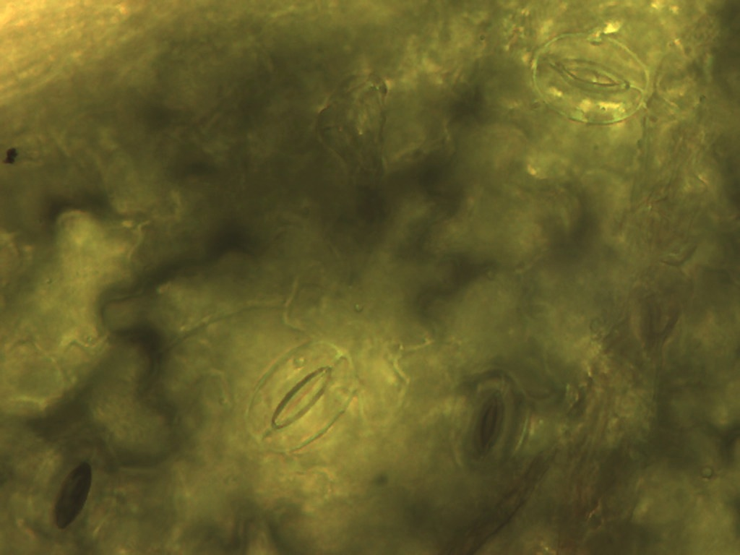
Notes:
162. Dandelion. Leaf epidermis, stomates (arrows), 40X.

